Slide 1
Fundamentals of Software Engineering
LECTURE 19: Software Testing

Slide 2
Software testing
Software testing is a process used to identify the correctness, completeness and quality of developed computer software. It is the process of executing a program / application under positive and negative conditions by manual or automated means. It checks for the :-
Specification
Functionality
Performance Software Testing

Slide 3
Software Testing
Software Testing is important as it may cause mission failure, impact on operational performance and reliability if not done properly.
Effective software testing delivers quality software products satisfying user’s requirements, needs and expectations. Why Software Testing ?

Slide 4
Why is testing needed
A defect in the software has a root cause, while the effect of defect is seen as impact by the different stake holders.
Testing is part of overall Quality Assurance – It covers the Quality Control aspect of ensuring Quality
A fault doesn't necessarily result in a failure, but a failure can only occur if a fault exists. To avoid a failure you must find the fault.
Software testing may be required for compliance with contractual or legal requirements

Slide 5
Why is testing needed
When is testing complete?
Actually never
However for practical reasons it is stopped after considering the risks involved, time and budget constraints

Slide 6
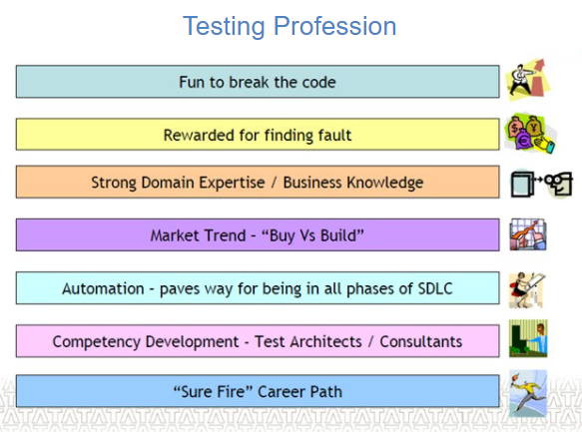

Slide 7
Who makes a Good tester
The tester’s mindset must have the below mentioned attributes
Keen Observation
Questioning Skills
“Never give-up” attitude
Interpersonal Skills
“Behind every great Developer there is an equally great Tester..””

Slide 8
What …????
…is an ”ERROR”??
….is a ”Bug”?? ….
is Fault, Failure ??

Slide 9
Bug, Fault & Failure
Error: An error is a human action that produces the incorrect result that results in a fault.
Bug : The presence of error at the time of execution of the software.
Fault : State of software caused by an error. Failure : Deviation of the software from its expected result. It is an event.
A person makes an Error That creates a fault in software That can cause a failure in operation

Slide 10
Who is a Software Tester??
Software Tester is the one who performs testing and find bugs, if they exist in the tested application.

Slide 11
The Testing Team
Program Manager
The planning and execution of the project to ensure the success of a project minimizing risk throughout the lifetime of the project.
Responsible for writing the product specification, managing the schedule and making the critical decisions and trade-offs.

Slide 12
The Testing Team
QA Lead
Coach and mentor other team members to help improve QA effectiveness
Work with other department representatives to collaborate on joint projects and initiatives
Implement industry best practices related to testing automation and to streamline the QA Department

Slide 13
The Testing Team
Test Analyst Lead
Responsible for planning, developing and executing automated test systems, manual test plans and regressions test plans.
Identifying the Target Test Items to be evaluated by the test effort
Defining the appropriate tests required and any associated Test Data
Gathering and managing the Test Data
Evaluating the outcome of each test cycle
Test Engineer
Writing and executing test cases and Reporting defects
Test engineers are also responsible for determining the best way a test can be performed in order to achieve 100% test coverage of all components

Slide 14
When to Start Testing in SDLC
Requirement
Analysis
Design
Coding
Testing
Implementation
Maintenance
Testing starts from Requirement Phase

Slide 15
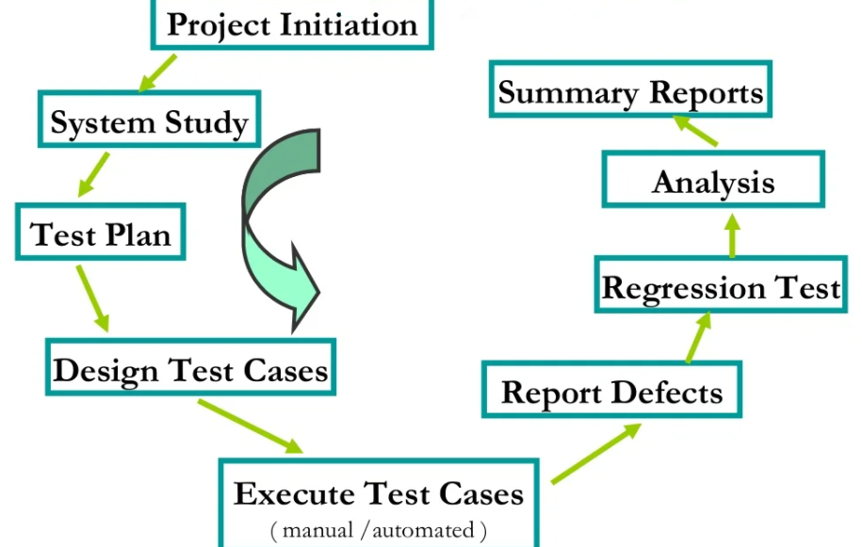
Testing life cycle

Slide 16
Test Plan
Test Plan A test plan is a systematic approach to testing a system i.e. software.
The plan typically contains a detailed understanding of what the eventual testing workflow will be.

Slide 17
Test Case
A test case is a specific procedure of testing a particular requirement. It will include:
Identification of specific requirement tested
Test case success/failure criteria
Specific steps to execute test
Test Data

Slide 18
Unit Testing
Test each module individually.
Follows a white box testing (Logic of the program)
Done by Developers

Slide 19
Integration Testing
After completing the unit testing and dependent modules development, programmers connect the modules with respect to HLD for Integration Testing through below approaches.

Slide 20
System Testing
After completing Unit and Integration testing through white box testing techniques development team release an .exe build (all integrated module) to perform black box testing.
Usability Testing
Functional Testing
Performance Testing
Security Testing

Slide 21
Usability Testing
During this test, testing team concentrates on the user friendliness of build interface. It consists of following sub tests.
User Interface Test: Ease of use (screens should be understandable to operate by End User)
Look & Feel :- attractive
Speed in interface :- Less number of task to complete task
Manual Support Test :- Context sensitiveness of user manual.

Slide 22
Functional Testing
The process of checking the behavior of the application.
It is geared to functional requirements of an application.
To check the correctness of outputs.
Data validation and Integration i.e. inputs are correct or not.

Slide 23
Performance Testing
LOAD TESTING – Also Known as Scalability Testing. During this test, test engineers execute application build under customer expected configuration and load to estimate performance.
STRESS TESTING – During this test, Test engineers estimates the peak load. To find out the maximum number of users for execution of out application user customer expected configuration to estimate peak load.
PEAK LOAD > CUSTOMER LOAD (EXPECTED)
DATA VOLUME TESING Testing team conducts this test to find the maximum limit of data volume of your application.

Slide 24
Security Testing
how well the system protects against unauthorized internal or external access, may require sophisticated testing techniques

Slide 25
Alpha Testing
The application is tested by the users who doesn’t know about the application.
Done at developer’s site under controlled conditions
Under the supervision of the developers

Slide 26
Acceptance Testing
A formal test conducted to determine whether or not a system satisfies its acceptance criteria and to enable the customer to determine whether or not to accept the system.
It is the final test action before deploying the software. The goal of acceptance testing is to verify that the software is ready and can be used by the end user to perform the functions for which the software was built.

Slide 27
Beta Testing
This Testing is done before the final release of the software to end-users.
Before the final release of the software is released to users for testing where there will be no controlled conditions and the user here is free enough to do what ever he wants to do on the system to find errors

Slide 28
Regression Testing
Testing with the intent of determining if bug fixes have been successful and have not created any new problems.
Also, this type of testing is done to ensure that no degradation of baseline functionality has occurred.

Slide 29
Validation
Validation is the process confirming that it meets the user’s requirements. It is the actual testing.
Verification : Is the Product Right
Validation : Is it the Right Product

Slide 30
Validation
Is about building the right thing,
Validation process determines if you have built the correct product for the customer,
Whether it meets all of their needs and requirement,
Checking whether the product specification is fulfilling the customers needs or not

Slide 31
Validation
It is a subjective process,
Used to assess how well the product is fulfilling or will fulfill the customer requirements,
Examples of process include:
Modeling
Simulation
User evaluation

Slide 32
Validation Example
You are developing a cell phone for your customers.
You conducted a survey and then collected the number of features to be included in the cell phone.
Then you started the production of it.
When the cell phone is launched in the end. It did not get the expected responses from the customers, and eventually it failed
You would say that the product could not be validated because it is not able to meet the customers requirement and needs.

Slide 33
Verification
Verification is the process confirming that -software meets its specification, done through inspections and walkthroughs.
Use – To identify defects in the product early in the life cycle

Slide 34
Verification
is about building the thing in the right way,
Verification process determines if you are building the product in the correct way as described in procedure manuals and all quality assurance and quality control activities are being performed as they are supposed to be,
Verification process checks that the product is being developed with all specifications are properly applied,
Verification is an objective process where product specifications and all quality requirements are documented well enough so that they could be measured and analyzed.

Slide 35
Verification example
let us say that you are developing a cell phone to be launched in the market.
You conducted the market research and then collected the numbers of functionalities to be included in the cell phone.
then you design the procedures to be used to build the product and specify the quality requirements for it.

Slide 36
Verification example
Now the production process has been started.
To make sure that everything is going according to plan,
you perform the inspection activities to the process,
then, you would say that the product has been verified and is being developed as you planned for it.

Slide 37
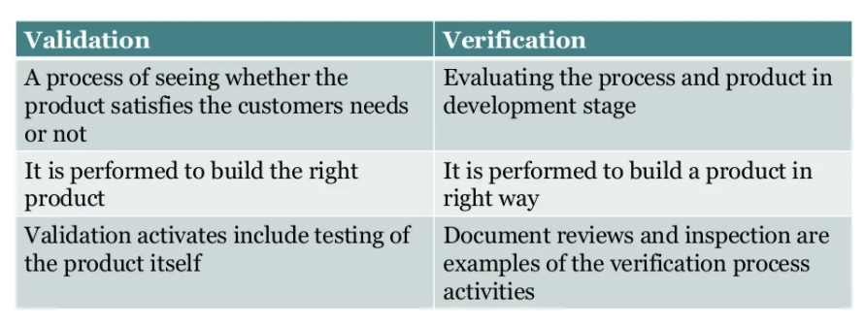

Slide 38
What is quality
Quality is defined as meeting the customer’s requirements and according to the standards
The best measure of Quality is given by FURPS ▪
Functionality
Usability
Reliability
Performance
Scalability

Slide 39
Why quality
Quality is the important factor affecting an organization’s long term performance.
Quality improves productivity and competitiveness in any organization. Why Quality ?

Slide 40
Quality Assurance
Quality Assurance is a planned and systematic set of activities necessary to provide adequate confidence that products and services will conform to specified requirements and meets user needs.
It is process oriented.
Defect prevention based.
Throughout the Life Cycle.
It’s a management process.

Slide 41
Quality Control
Quality control is the process by which product quality is compared with the applicable standards and the action taken when non conformance is detected.
It is product oriented
Defect detection based

Slide 42
